Slide 1
























eVEnt-DRivEn & seRviCE- BAsEd aRcHiTEctUrEs
@neal4d nealford.com

Slide 2

Monoliths

Slide 3
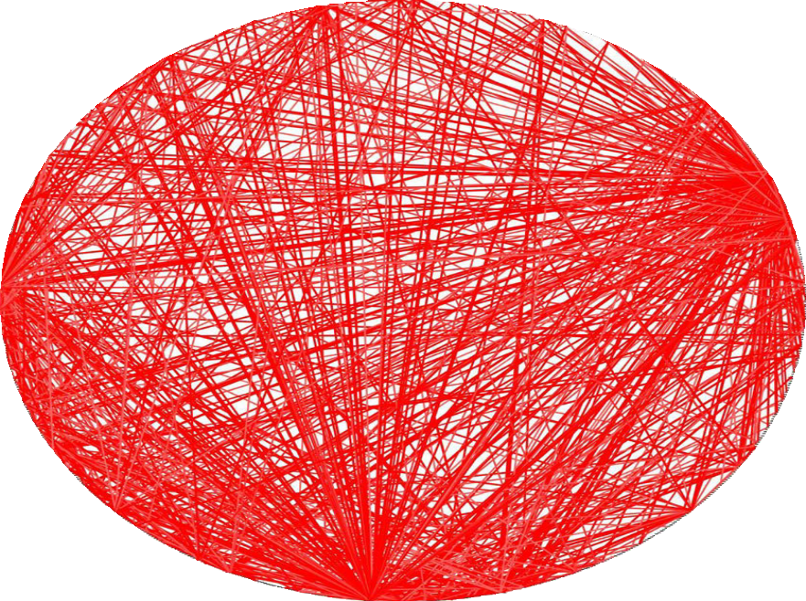




monoliths
“Big Ball of Mud”
https://en.wikipedia.org/wiki/Big_ball_of_mud

Slide 4
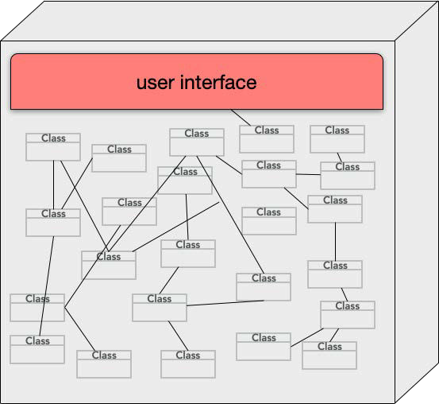


monoliths
“Big Ball of Mud”
https://en.wikipedia.org/wiki/Big_ball_of_mud
unstructured monolith

Slide 5
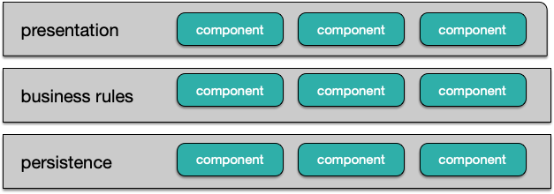


monoliths
layered architecture
“Big Ball of Mud”
https://en.wikipedia.org/wiki/Big_ball_of_mud
unstructured monolith

Slide 6

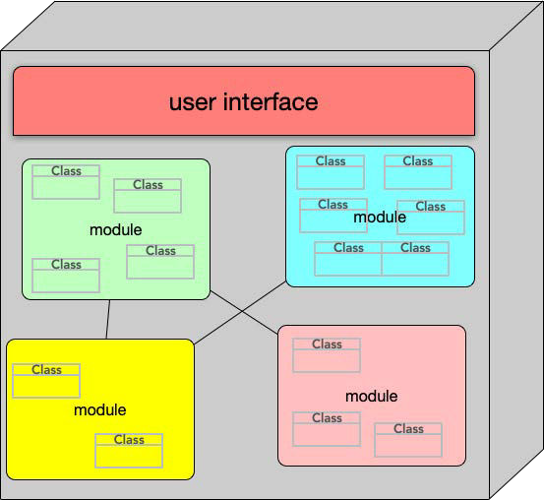

monoliths
layered architecture
“Big Ball of Mud”
https://en.wikipedia.org/wiki/Big_ball_of_mud
unstructured monolith
modular monolith
http://www.codingthearchitecture.com/presentations/sa2015-modular-monoliths

Slide 7

monoliths
“Big Ball of Mud”
https://en.wikipedia.org/wiki/Big_ball_of_mud
unstructured monolith
layered architecture
modular monolith
http://www.codingthearchitecture.com/presentations/sa2015-modular-monoliths

Slide 8



monoliths
layered architecture
modular monolith

Slide 9



monoliths
technical partitioning
layered architecture
modular monolith

Slide 10
monoliths
technical partitioning
domain partitioning
layered architecture
modular monolith

Slide 11

Event-driven Architectures

Slide 12







origins: hubs

Slide 13




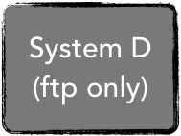
origins: hubs

Slide 14

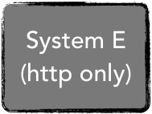

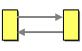
origins: hubs

Slide 15
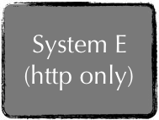




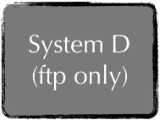
origins: hubs

Slide 16









origins: hubs

Slide 17

origins: hubs

Slide 18
origins: hubs

Slide 19


origins: hubs

Slide 20
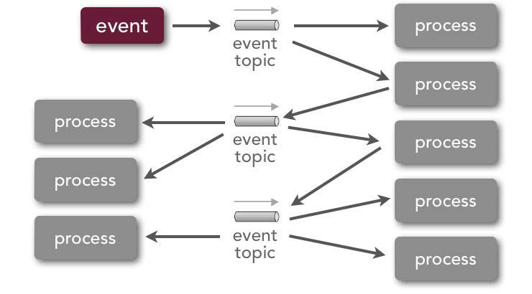
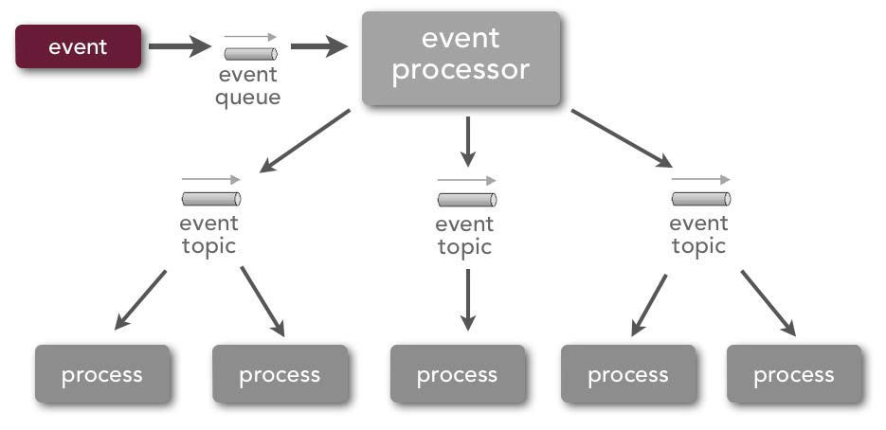
Event-driven Architectures
broker topology
mediator topology

Slide 21
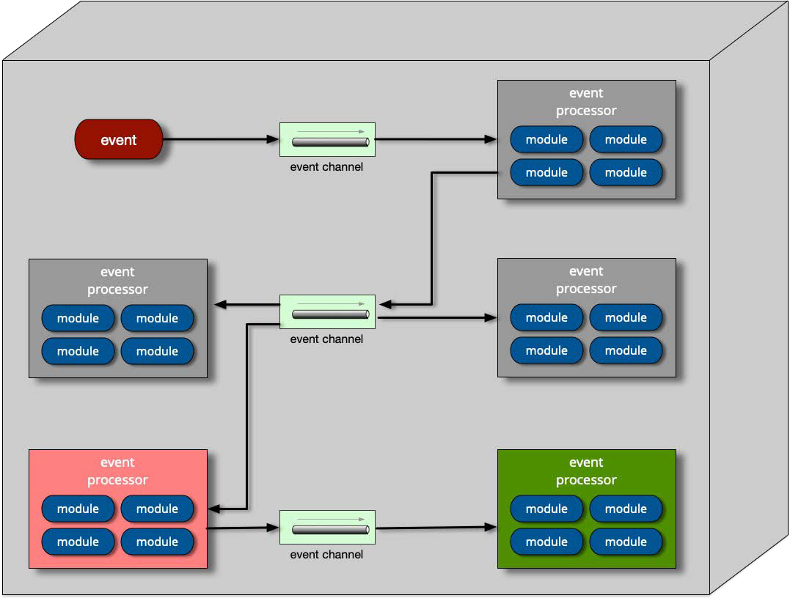
Broker Base Architecture

Slide 22













Broker Message Passing
you moved!
customer process
you move...
quote process
claims process
notification process
adjustment process

Slide 23


Broker Message Passing
you moved!
customer process
you move...
changed address
quote process
claims process
notification process
adjustment process

Slide 24


Broker Message Passing
you moved!
customer process
you move...
changed address
quote process
claims process
notification process
adjustment process

Slide 25




Broker Message Passing
customer process
you move...
quote process
claims process
recalc'd quote
updated claims
notification process
adjustment process

Slide 26





Broker Message Passing
customer process
you move...
quote process
claims process
updated claims
recalc'd quote
updated claims
notification process
adjustment process

Slide 27
Broker: Choreography
customer process
you move...
quote process
claims process
notification process
adjustment process

Slide 28
























Broker: Errors?
you moved!
customer process
change address
change address
Error handling?
quote process
claims process
recalc quote
update claims
update claims
notification process
adjustment process

Slide 29




Broker: Evolution
customer process
evolution
quote process
claims process
audit process
notification process
adjustment process

Slide 30




Broker: Asynchronous Notification
customer process
Unified notification message to customer?
quote process
claims process
In asynchronous systems, coordination happens at the end
notification process
adjustment process

Slide 31
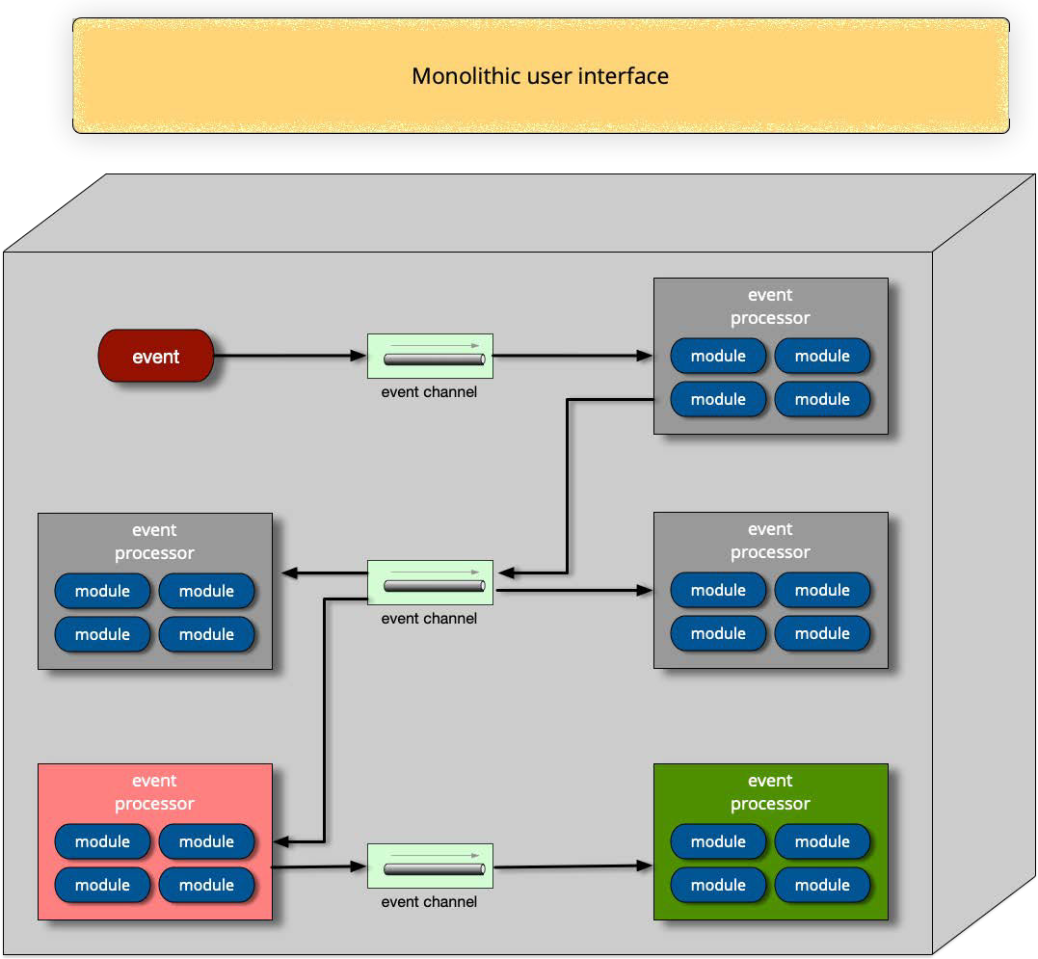
Broker: UI

Slide 32
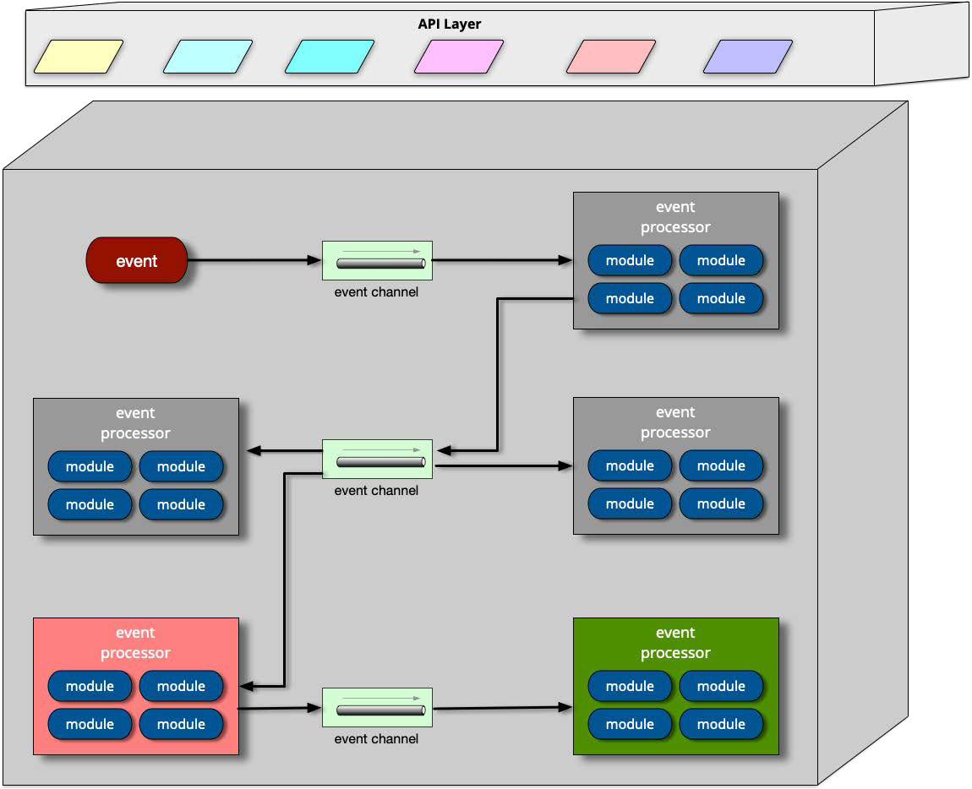
Broker: UI

Slide 33
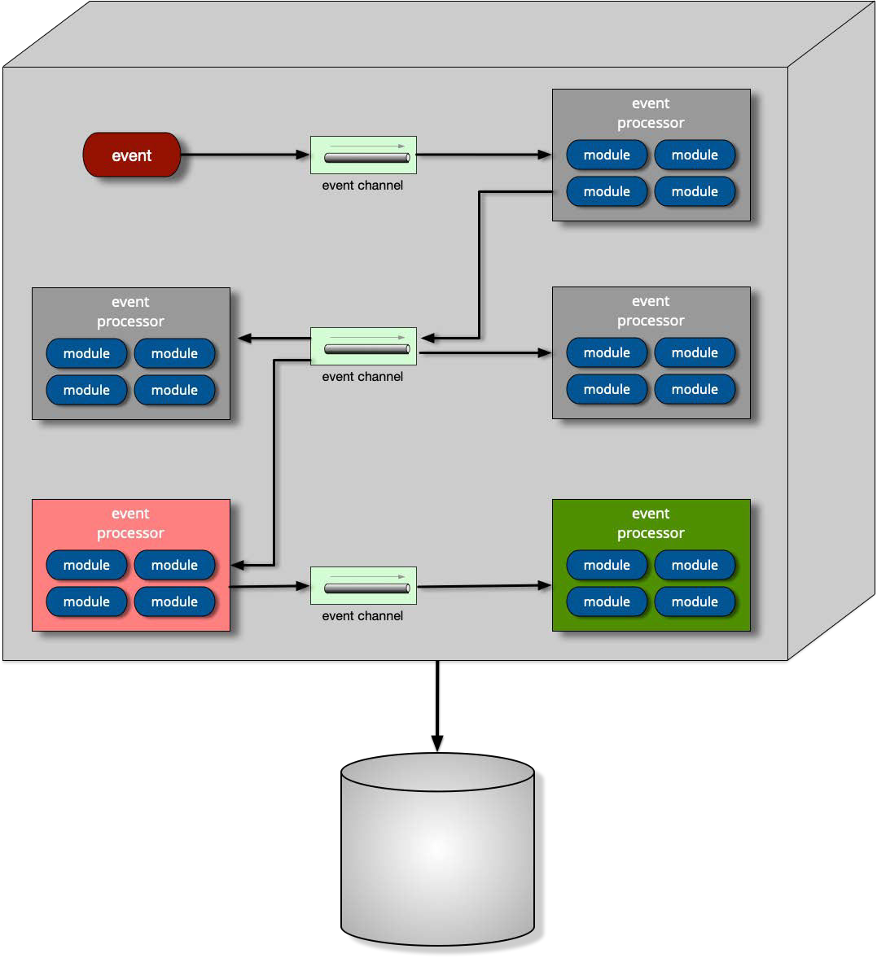
Broker: Data

Slide 34
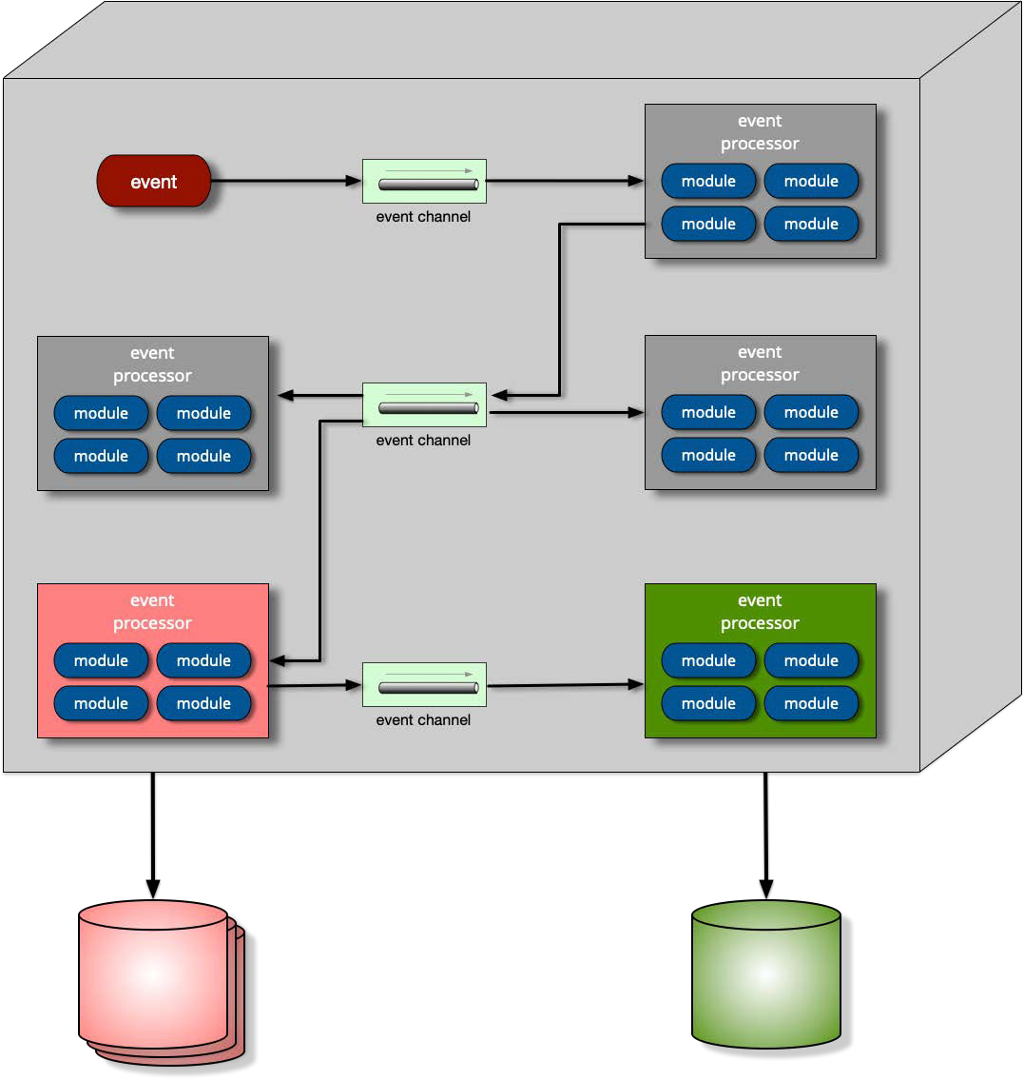
Broker: Data

Slide 35
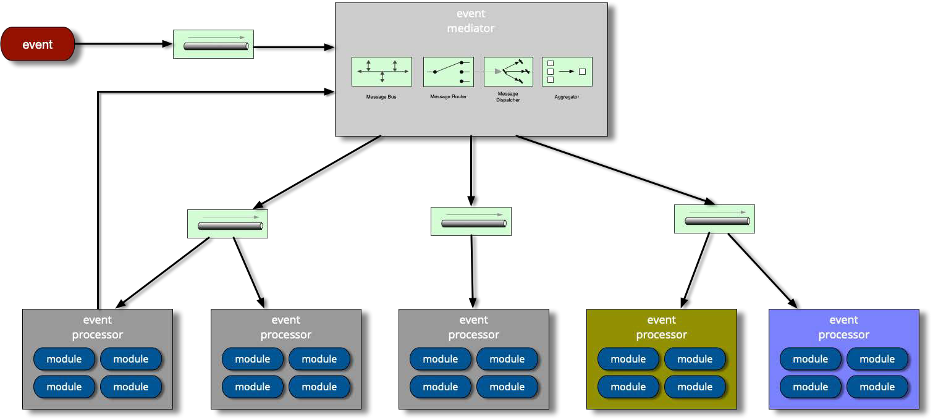
Meditator EDA

Slide 36




Meditator EDA
projects.spring.io/spring-webflow/

Slide 37




Meditator EDA
camel.apache.org/
projects.spring.io/spring-webflow/

Slide 38




Meditator EDA
camel.apache.org/
projects.spring.io/spring-webflow/
www.mulesoft.com/

Slide 39



Meditator EDA
camel.apache.org/
projects.spring.io/spring-webflow/
www.mulesoft.com/
ode.apache.org/

Slide 40
Meditator EDA

Slide 41
Meditator EDA

Slide 42

































Mediator Message Flow
you moved
you move...
process engine
change address
recalc quote
update claims
adjust claims
notify insured
customer process
quote process
claims process
adjustment process
notification process

Slide 43

Mediator Message Flow
you moved
you move...
process engine
change address
recalc quote
update claims
adjust claims
notify insured
customer process
quote process
claims process
adjustment process
notification process

Slide 44

Mediator Message Flow
you moved
you move...
process engine
change address
recalc quote
update claims
adjust claims
notify insured
customer process
quote process
claims process
adjustment process
notification process

Slide 45

Mediator Message Flow
you moved
you move...
process engine
change address
recalc quote
update claims
adjust claims
notify insured
customer process
quote process
claims process
adjustment process
notification process

Slide 46

Mediator Message Flow
you moved
you move...
process engine
change address
recalc quote
update claims
adjust claims
notify insured
customer process
quote process
claims process
adjustment process
notification process

Slide 47

Mediator Message Flow
you moved
you move...
process engine
change address
recalc quote
update claims
adjust claims
notify insured
customer process
quote process
claims process
adjustment process
notification process

Slide 48



































event-driven architecture
you moved
you move...
process engine
Error handling?
change address
recalc quote
update claims
adjust claims
notify insured
customer process
quote process
claims process
adjustment process
notification process

Slide 49




event-driven architecture
you moved
you move...
process engine
Unified notification message to customer?
change address
recalc quote
update claims
adjust claims
notify insuredinsured
customer process
quote process
claims process
adjustment process
notification process

Slide 50



event-driven architecture
you moved
you move...
process engine
evolution
change address
recalc quote
update claims
adjust claims
notify insured
customer process
quote process
claims process
adjustment process
notification process
audit process

Slide 51














event-driven architecture
you moved
evolution
you move...
process engine
change address
recalc quote
update claims
adjust claims
audit
notify insured
customer process
quote process
claims process
adjustment process
notification process
audit process

Slide 52
Mediator: Orchestration
you moved
you move...
process engine
change address
recalc quote
update claims
adjust claims
notify insured
customer process
quote process
claims process
adjustment process
notification process

Slide 53
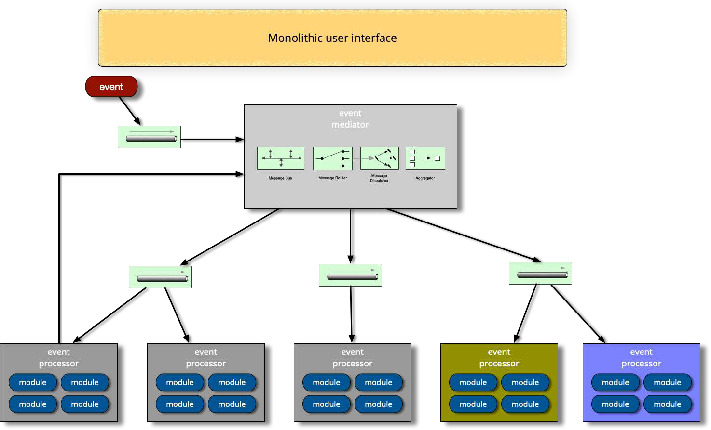
Mediator: UI

Slide 54
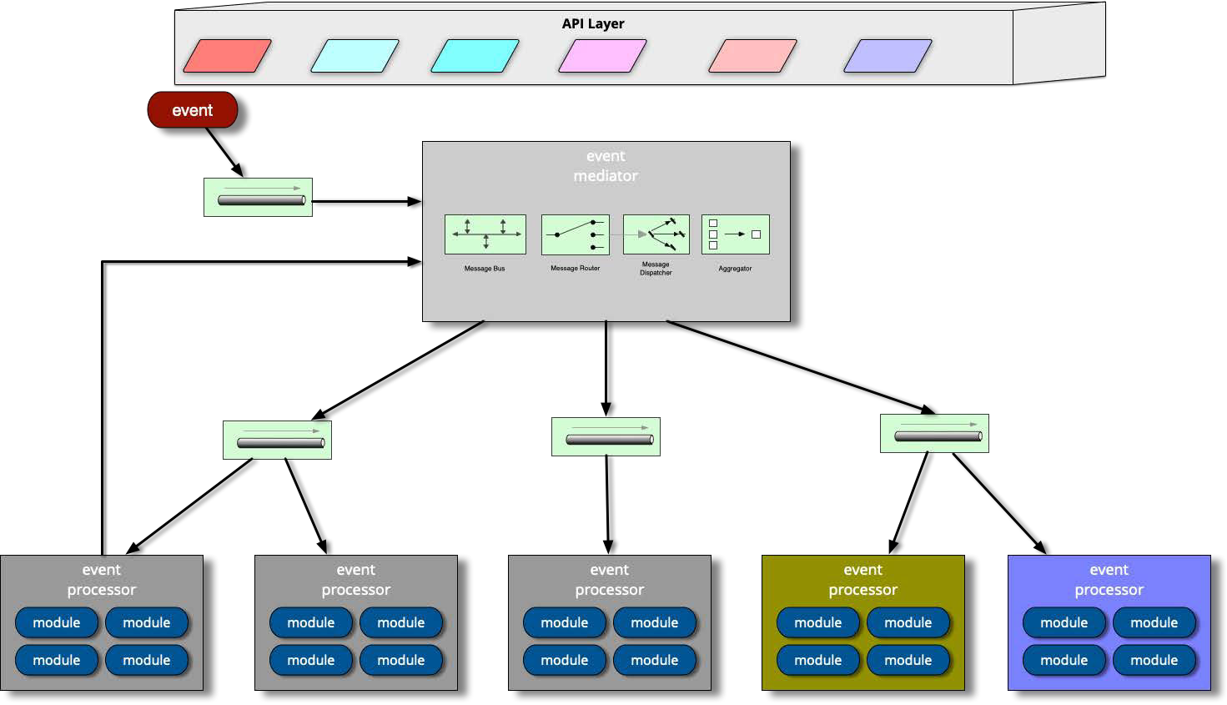
Mediator: UI

Slide 55
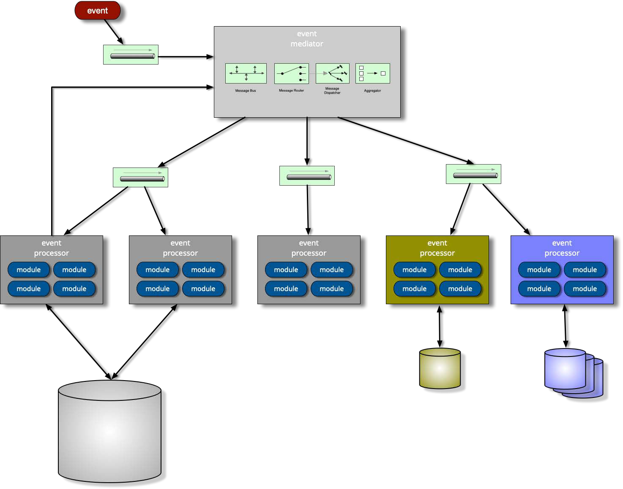
Mediator: Data

Slide 56

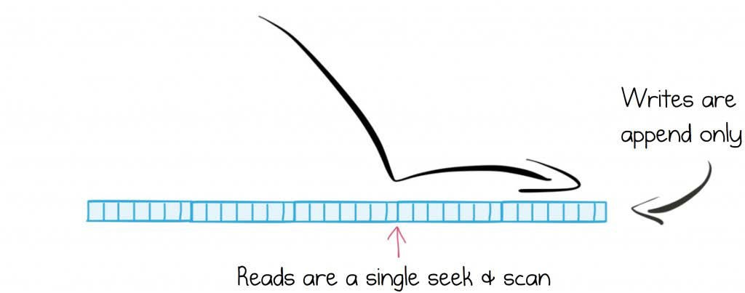
Structured logs

Slide 57
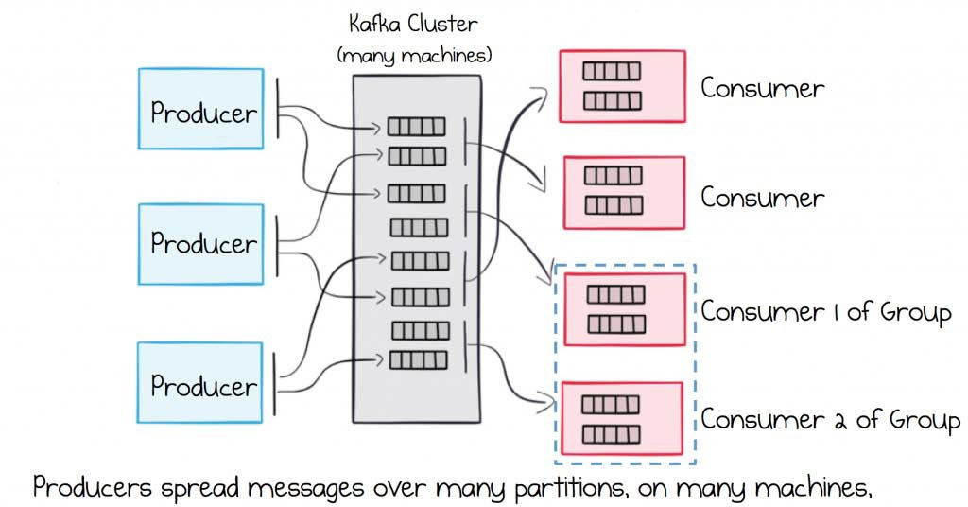

Slide 58
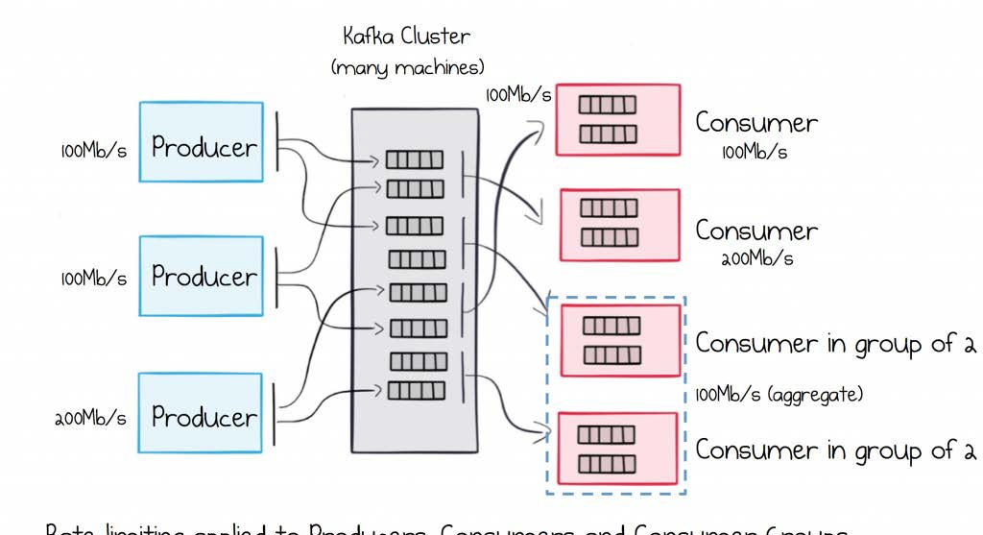

Slide 59
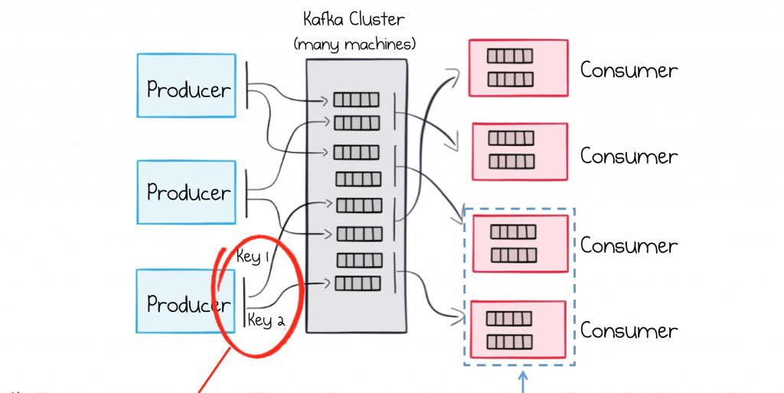

Slide 60
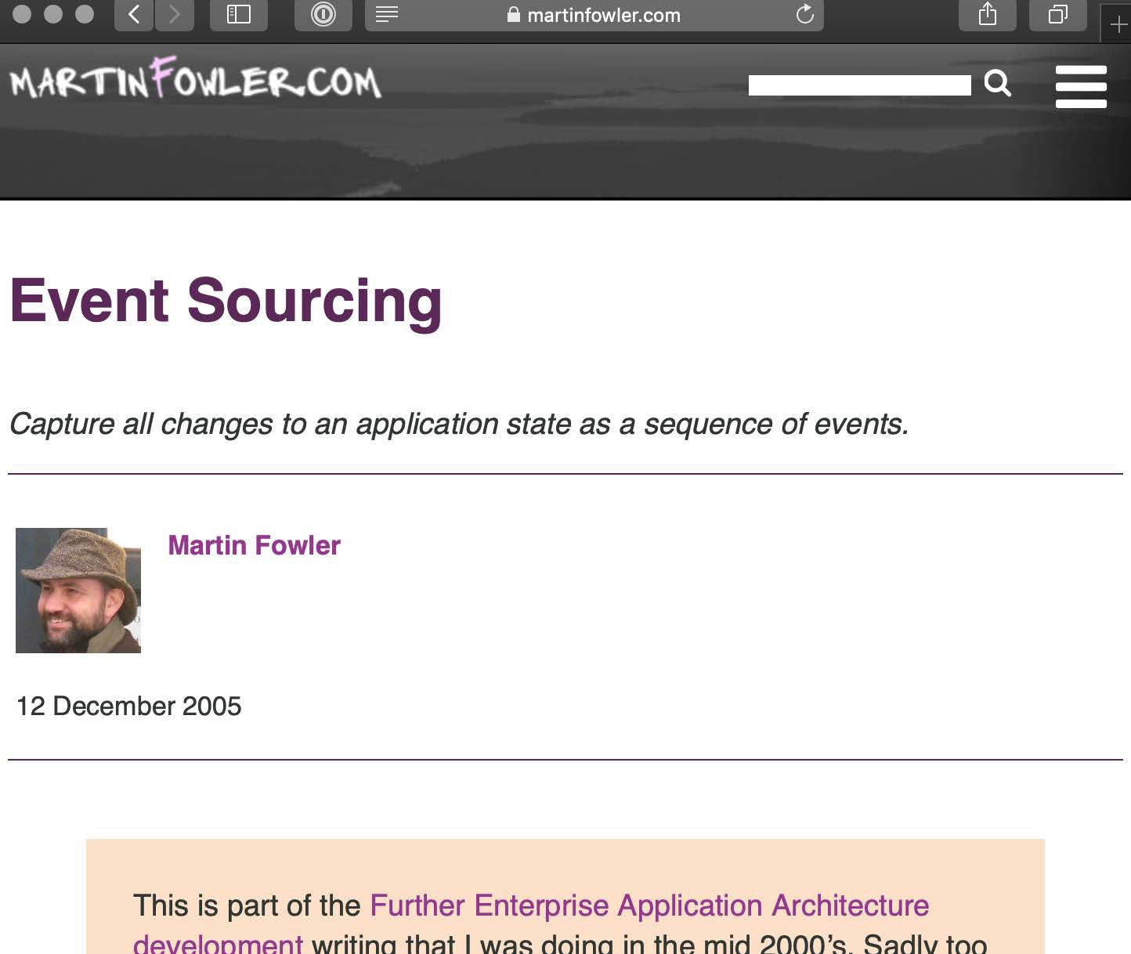

https://martinfowler.com/eaaDev/EventSourcing.html

Slide 61
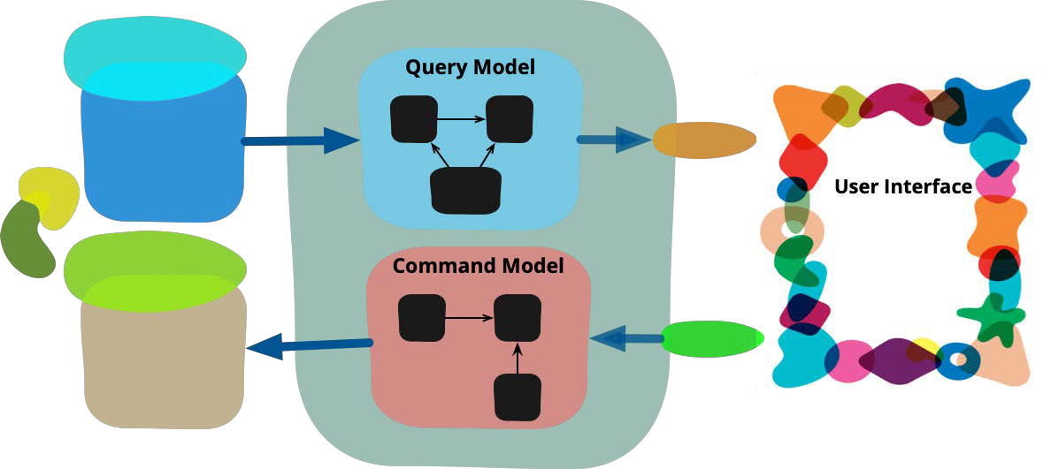
CQRS
http://codebetter.com/gregyoung/2010/02/16/cqrs-task-based-uis-event-sourcing-agh/

Slide 62
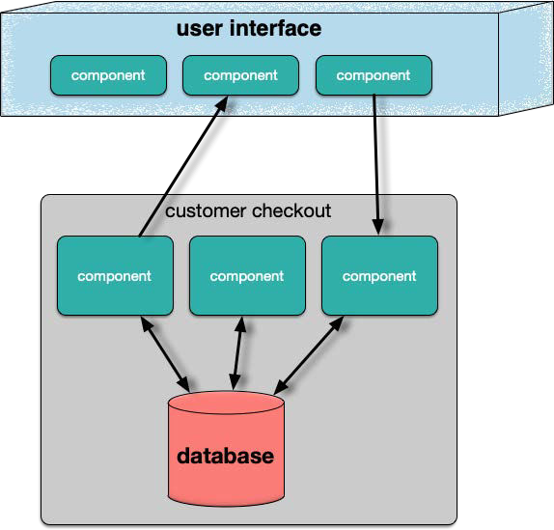
traditional

Slide 63
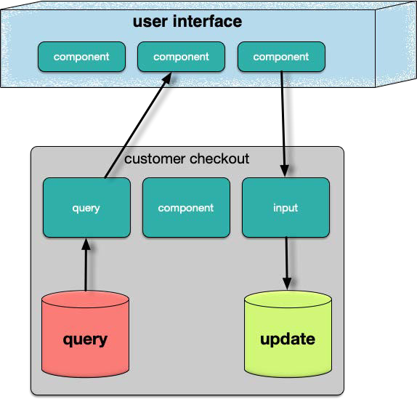
CQRS
Command Query Responsibility Separation

Slide 64
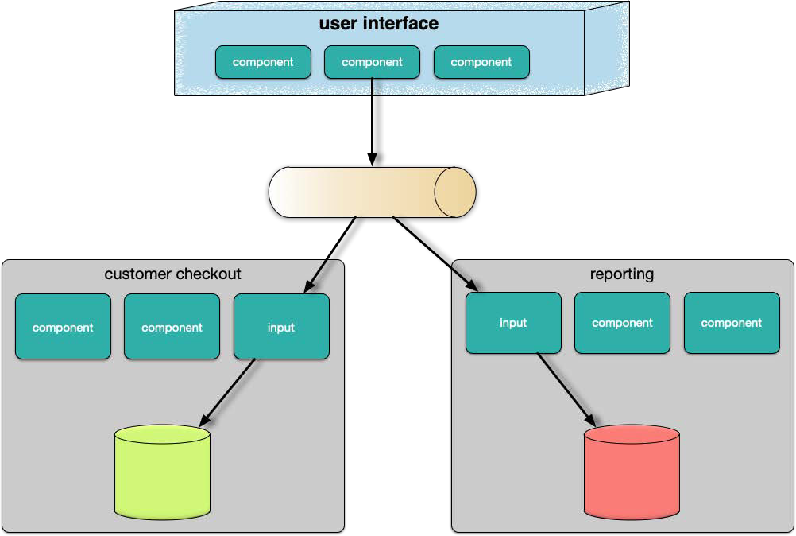
eventual consistency, events, & reports

Slide 65
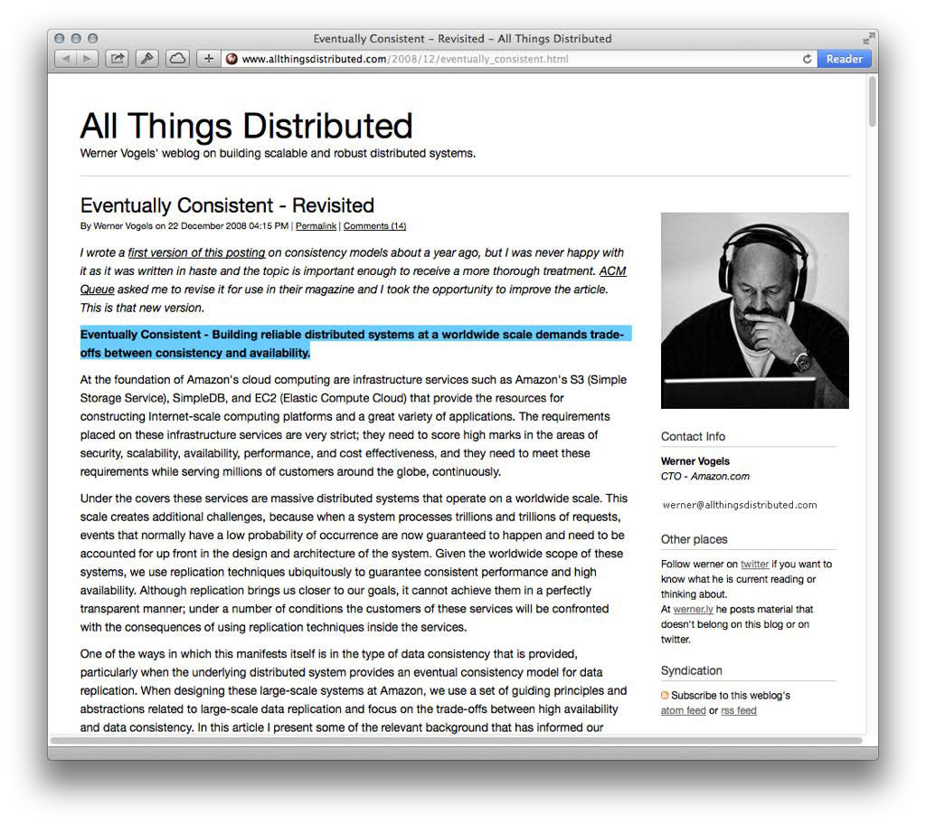

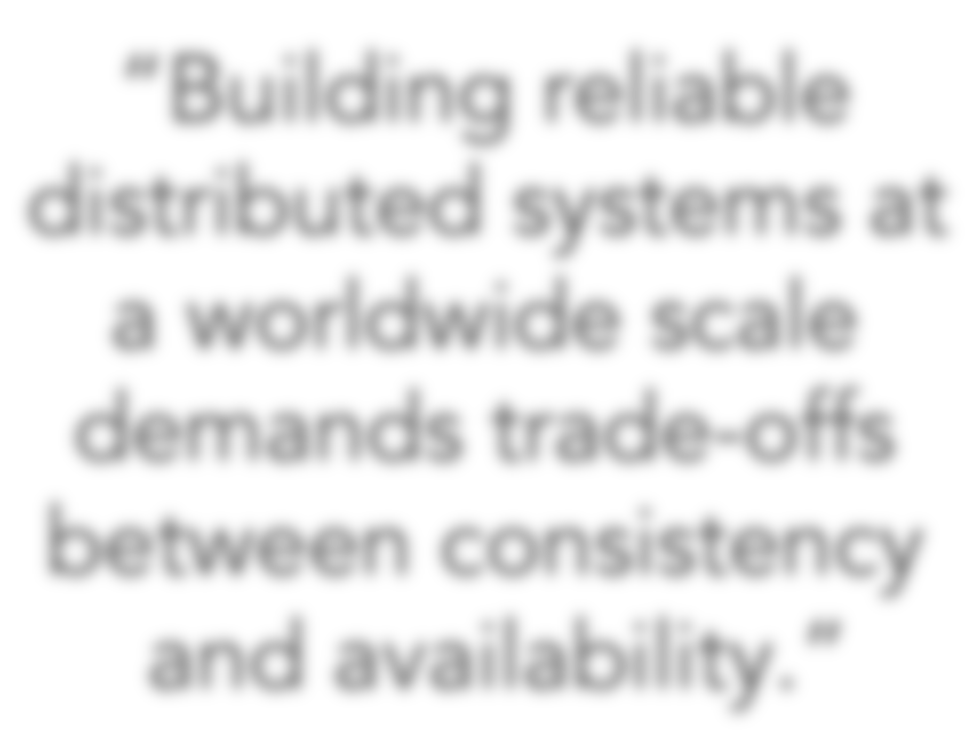
eventual consistency
“Building reliable distributed systems at a worldwide scale demands trade-offs between consistency and availability.”
http://www.allthingsdistributed.com/2008/12/eventually_consistent.html

Slide 66
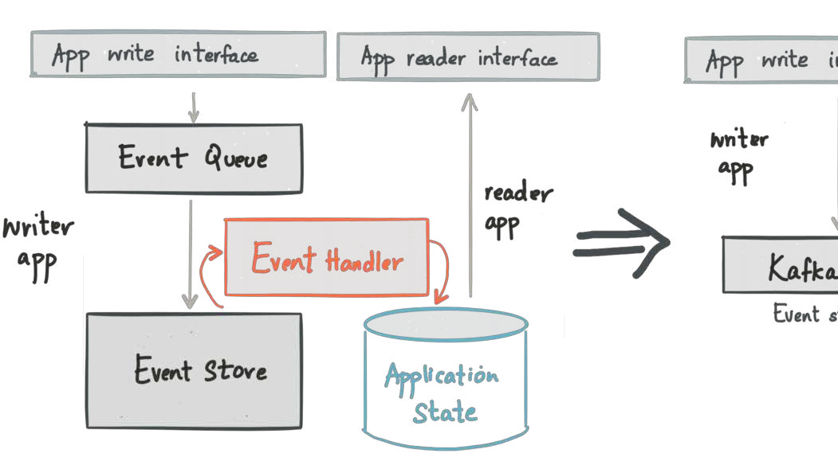
CQRS

Slide 67
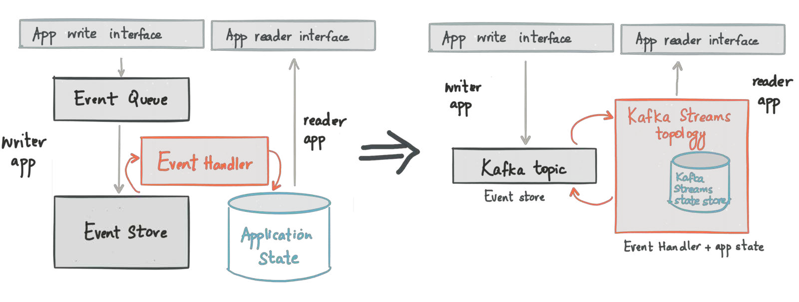
CQRS

Slide 68
Mediator or Broker?

Slide 69
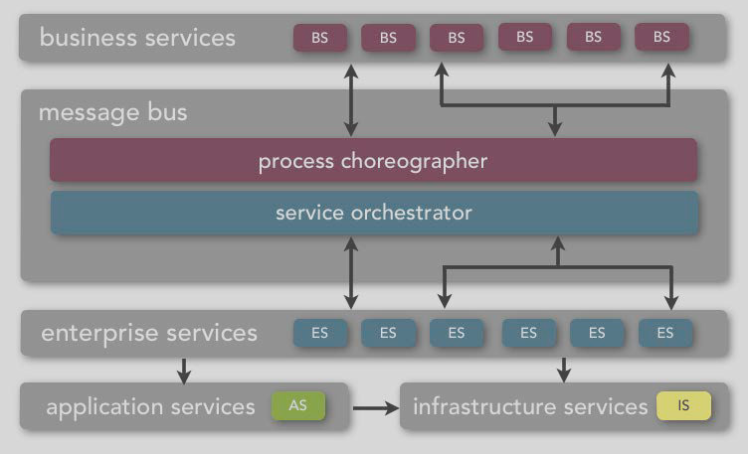


sERviCe-oRieNtEd ArcHiTeCtuRe

Slide 70
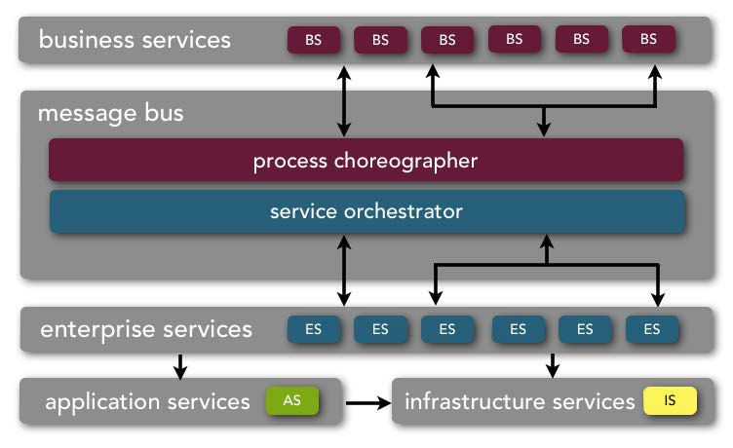
service-oriented architecture
abstraction

Slide 71
service-oriented architecture
abstraction service taxonomy

Slide 72
service-oriented architecture
abstraction service taxonomy shared resources

Slide 73
service-oriented architecture
abstraction service taxonomy shared resources middleware

Slide 74
service-oriented architecture
abstraction service taxonomy shared resources middleware interoperability

Slide 75































service-oriented architecture
business services
BS
BS
BS
BS
BS
BS
message bus
process choreographer service orchestrator
enterprise services
ES
ES
ES
ES
ES
ES
application services
AS
infrastructure services
IS

Slide 76
service-oriented architecture
business services
BS
BS
BS
BS
BS
BS
message bus
process choreographer service orchestrator
enterprise services ^{ES ES ES ES ES ES}
application services ^{AS} infrastructure services ^{IS}

Slide 77
service-oriented architecture
business services
BS
BS
BS
BS
BS
BS
message bus
process choreographer service orchestrator
enterprise services ^{ES ES ES ES ES ES}
application services ^{AS} infrastructure services ^{IS}
coarse-grained

Slide 78
service-oriented architecture
business services
BS
BS
BS
BS
BS
BS
message bus
process choreographer service orchestrator
enterprise services ^{ES ES ES ES ES ES}
application services ^{AS} infrastructure services ^{IS}
abstract
coarse-grained

Slide 79
service-oriented architecture
business services
BS
BS
BS
BS
BS
BS
message bus
process choreographer service orchestrator
enterprise services ^{ES ES ES ES ES ES}
application services ^{AS} infrastructure services ^{IS}
abstract
enterprise-level
coarse-grained

Slide 80
service-oriented architecture
business services
BS
BS
BS
BS
BS
BS
message bus
process choreographer service orchestrator
enterprise services ^{ES ES ES ES ES ES}
application services ^{AS} infrastructure services ^{IS}
abstract
enterprise-level coarse-grained
owned and defined by business users
data represented as WSDL, BPEL, XML, etc.

Slide 81






service-oriented architecture
business services
BS
BS
BS
BS
BS
BS
message bus
process choreographer service orchestrator
enterprise services ^{ES ES ES ES ES ES}
application services ^{AS} infrastructure services ^{IS}
abstract
enterprise-level coarse-grained
owned and defined by business users
data represented as WSDL, BPEL, XML, etc.
no implementation - only name, input, and output
ExecuteTrade
PlaceOrder
ProcessClaim

Slide 82


service-oriented architecture
business services
BS
BS
BS
BS
BS
BS
message bus
process choreographer service orchestrator
enterprise services ^{ES ES ES ES ES ES}
application services ^{AS} infrastructure services ^{IS}
abstract
enterprise-level coarse-grained
owned and defined by business users
data represented as WSDL, BPEL, XML, etc.
no implementation - only name, input, and output
Are we in the business of…?
ExecuteTrade PlaceOrder ProcessClaim

Slide 83
service-oriented architecture
business services
BS
BS
BS
BS
BS
BS
message bus
process choreographer service orchestrator
enterprise services
ES
ES
ES
ES
ES
ES
application services
AS
infrastructure services
IS

Slide 84
service-oriented architecture
business services ^{BS BS BS BS BS BS}
message bus
process choreographer service orchestrator
enterprise services
ES
ES
ES
ES
ES
ES
application services ^{AS} infrastructure services ^{IS}

Slide 85
service-oriented architecture
owned by shared services teams
business services ^{BS BS BS BS BS BS}
message bus
process choreographer service orchestrator
enterprise services
ES
ES
ES
ES
ES
ES
application services ^{AS} infrastructure services ^{IS}

Slide 86
service-oriented architecture
owned by shared services teams
coarse-grained
business services ^{BS BS BS BS BS BS}
message bus
process choreographer service orchestrator
enterprise services
ES
ES
ES
ES
ES
ES
application services ^{AS} infrastructure services ^{IS}

Slide 87
service-oriented architecture
owned by shared services teams
business services ^{BS BS BS BS BS BS}
message bus
process choreographer service orchestrator
enterprise-level
coarse-grained
enterprise services
ES
ES
ES
ES
ES
ES
application services ^{AS} infrastructure services ^{IS}

Slide 88
service-oriented architecture
owned by shared services teams
business services ^{BS BS BS BS BS BS}
message bus
process choreographer service orchestrator
concrete
enterprise-level
coarse-grained
enterprise services
ES
ES
ES
ES
ES
ES
application services ^{AS} infrastructure services ^{IS}

Slide 89
service-oriented architecture
owned by shared services teams
business services ^{BS BS BS BS BS BS}
message bus
process choreographer service orchestrator
concrete
enterprise-level
coarse-grained
custom or vendor implementations that are one-to-one or one-to-many relationship with business services
enterprise services
ES
ES
ES
ES
ES
ES
application services ^{AS} infrastructure services ^{IS}

Slide 90






service-oriented architecture
owned by shared services teams
business services ^{BS BS BS BS BS BS}
message bus
process choreographer service orchestrator
concrete
enterprise-level
coarse-grained
custom or vendor implementations that are one-to-one or one-to-many relationship with business services
enterprise services
ES
ES
ES
ES
ES
ES
application services ^{AS} infrastructure services ^{IS}
CreateCustomer
CalcQuote
ValidateTrade

Slide 91
service-oriented architecture
business services
BS
BS
BS
BS
BS
BS
message bus
process choreographer service orchestrator
enterprise services
ES
ES
ES
ES
ES
ES
application services
AS
infrastructure services
IS

Slide 92
service-oriented architecture
business services ^{BS BS BS BS BS BS}
message bus
process choreographer service orchestrator
enterprise services ^{ES ES ES ES ES ES}
infrastructure services ^{IS}
application services
AS

Slide 93
service-oriented architecture
business services ^{BS BS BS BS BS BS}
message bus
process choreographer service orchestrator
enterprise services ^{ES ES ES ES ES ES}
owned by application teams
infrastructure services ^{IS}
application services
AS

Slide 94
service-oriented architecture
business services ^{BS BS BS BS BS BS}
message bus
process choreographer service orchestrator
enterprise services ^{ES ES ES ES ES ES}
owned by application teams
fine-grained
infrastructure services ^{IS}
application services
AS

Slide 95
service-oriented architecture
business services ^{BS BS BS BS BS BS}
message bus
process choreographer service orchestrator
enterprise services ^{ES ES ES ES ES ES}
owned by application teams
concrete
fine-grained
infrastructure services ^{IS}
application services
AS

Slide 96
service-oriented architecture
business services ^{BS BS BS BS BS BS}
message bus
process choreographer service orchestrator
enterprise services ^{ES ES ES ES ES ES}
owned by application teams
concrete
application-level
fine-grained
infrastructure services ^{IS}
application services
AS

Slide 97
service-oriented architecture
business services ^{BS BS BS BS BS BS}
message bus
process choreographer service orchestrator
enterprise services ^{ES ES ES ES ES ES}
owned by application teams
concrete
application-level
fine-grained
bound to a specific application context
infrastructure services ^{IS}
application services
AS

Slide 98






service-oriented architecture
business services ^{BS BS BS BS BS BS}
message bus
process choreographer service orchestrator
enterprise services ^{ES ES ES ES ES ES}
owned by application teams
concrete
application-level
fine-grained
bound to a specific application context
AddDriver
UpdateAddress
CalcSalesTax
infrastructure services ^{IS}
application services
AS

Slide 99
service-oriented architecture
business services
BS
BS
BS
BS
BS
BS
message bus
process choreographer service orchestrator
enterprise services
ES
ES
ES
ES
ES
ES
application services
AS
infrastructure services
IS

Slide 100
service-oriented architecture
business services ^{BS BS BS BS BS BS}
message bus
process choreographer service orchestrator
enterprise services ^{ES ES ES ES ES ES}
application services ^{AS}
infrastructure services
IS

